Slide 1
Investing with Fast Thinking
Presented by Roger Shi

Slide 2
Agenda
First, introduction
Findings
Second, institutional background and main hypotheses
Third, analyzes investment decision using fast thinking
Fourth, examine the roles of time pressure and salience, respectively
Finally we analyze our learning and concludes

Slide 3
Introduction
Contributes to the psychology and economics literature on cognitive biases
First paper investigate the effect of fast thinking on investment decisions
Adds to the literature on learning from experience
Showing that participants and observers respond differently even if they are provided with the same data
Relates to research on the role of limited attention in financial markets.
The paper shows that time pressure leads investors to fixate on interest rates and ignore valuable information that is freely available on the trading interface
Adds to the literature on “nudging”
By making credit rating more salient, we can nudge investors to pay more attention to credit risk and improve their investment decisions
On P2P lending
The results of the paper can help investors avoid the trap of fast thinking and improve the quality of their investment decisions

Slide 4
Introduction
Two-system approach to judgment and choice
System 1 operates automatically and quickly with no little or no effort (Fast thinking)
System 2 is slow and deliberate, allocating attention to effortful mental activities (Slow thinking)
Peer-to-peer lending market is ideal for analyzing investments using fast thinking(3 features)
Have to make quick decision (further discussion later)
Renrendai records time stamps for all transactions so we can measure
Renrendai is a sizeable market with long sample period

Slide 5
Findings
1. Under pressure, investors rush to invest in loans with high interest rates, but disregard borrowers credit rating
2. Incorporating the information in credit ratings can significantly improve investment returns
3. When time pressure is stronger, investors rely more on interest rates
4. By making credit rating information more sailent, we can “nudge” investors into better decisions
5. Firsthand experience matter! (Stranger’s tear is just water)
Wealth effect? Selection effect? Inattention?
See next slides ☺

Slide 6
Why do participants and observers learn differently?
Wealth effect: participants experience a negative wealth shock from the default, while observers do not
Selection effect: individuals with low ability (低端人口) might stop investing after experiencing a default
Inattention: investors may pay more attention to defaults on their own loans
These three effects are absent or negligible from controlled experiment

Slide 7
Institutional background
Data from Renrendai
Renrendai was founded in 2010 and has an AAA
P2P was first introduced in China in 2007 and grew rapidly from 2011 to 2015
Credit loan
No collateral (76% of all loan during our sample period)
Provide identification information as well as income information, employment, and creditworthiness
AA, A,B,C,D,E, and HR (i.e High Risk)
Borrower’s credit rating was updated monthly based on the repayment status

Slide 8
continue
Max amount depends on credit quality (3,000 rmb~~~500,000 rmb)
3,6,9,12,15,18,24 and 36 months
Borrowers specify the interest rates (there is a min set by Renrendai based on credit rating)
Our sample 10% to 24%
Renrendai denies around 95% because of poor credit rating or insufficient verifications
Once approved applications can be viewed by all potential investors
See next slides for the sample loan on the Renrendai website

Slide 10
continue
Free for investors
Multiples of 50rmb at a loan’s pre-specified interest rate
If a loan cannot be fully funded in seven days, the funding process stops
The borrower either receive 100% funding or no funding at all
Prepayment is allowed but with a penalty of 1% of the outstanding balance
Time stamps for each investor’s commitment (real time)
This feature allows us to calculate the timing of each loan process to the seconds which is unique
Not feasible on other platforms such as Prosper.com

Slide 11
Hypotheses
Renrendai is ideal for studying financial decision-making using fast thinking
Pressure
Banks in China keep interest artificially low so P2P can provide better return (贪不到便宜就是吃亏）
More than 90% of loans are fully funded within 8 mins
Principal guaranteed
-investors only lose interest payment
Pressure and principal
Conjecture that interest rate is the variable on which investors focus because time pressure and principal guarantee
System 1 decision making

Slide 12
Investing with fast thinking
Data
9.1.2012 ~12.31.2014 (contains 10,385 loans funded by 25,314 unique investors)
Exclude loans before 9.1.2012 because no start time if the funding process before this date
Exclude loans after 12.31.2014 because the repayment status of most of these loans is not yet available at the end of our sample
Thinking fast
fulfullmentTime: a loan is listed to the time when the loan is fully funded
“fast loan” fulfillmentTime < 42 sec
Next slides will show the contrast between fast loans and all other loans

Slide 13
Fast loans are smaller
Fast loans offer higher interest rates
Similar terms
High default rate (19.8% vs 16.7%)
High IRR (11.67% vs. 10.53%)
Fast loan’s borrowers are younger and less likely to be employed for more than three years
Overall, fast loans appear risker than other loans

Slide 14
Primacy of interest rate
Test whether investors’ decision speed depends on interest rate
Run OLS regression of Ln(fulfillmentTime) on Interest Rate and HR (dummy variable, 1 for high risk and 0 otherwise)
See next slide for more

Slide 15
CONTINUE
The coefficient estimate for interest rate is -0.206, with a t-statistic of over 19
This means a one-standard-deviation increase in the interest rate reduces fulfullmentTime by 57%
Ex, median fulfullmentTime (80s), a 1std increase in the interest rate(2.2) reduces fulfillmentTime to 34s
In contrast, the coefficient estimate for HR is -0.036 (t=1.28)
If investors avoided loans with HR ratings, this coefficient would be positive rather than negative1

Slide 16
Loan performance
Loan return and interest rate
Given the principal guarantee, the performance of a loan should have a strong positive association with its interest rate.
IRR-CD Rate, where Irr is the realized internal rate of return of the loan and CD rate is the rate of return for a bank deposit with a similar term
T is the time to maturity repayment(t) is the realized cash flow at time t,which may be a scheduled payment, a prepayment from the borrower, or the payment from renrendai when the borrower defaults
See next page for the regression table

Slide 17
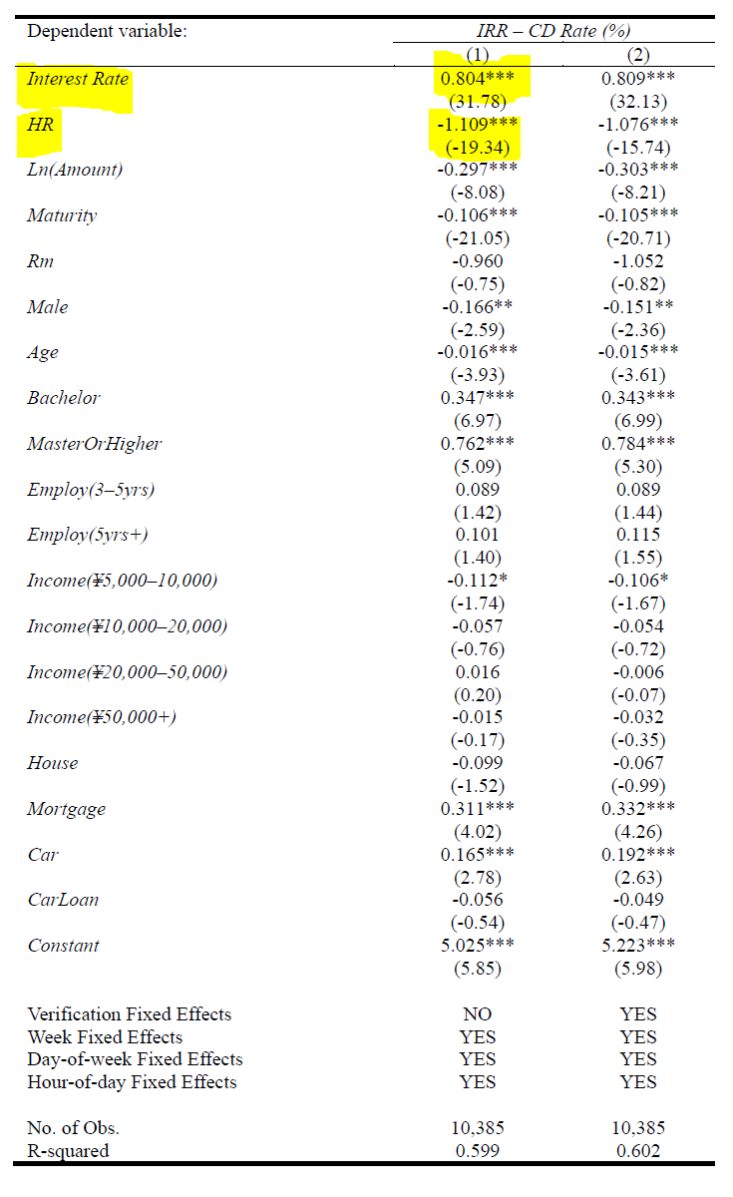
CONTINUE
1% increase in the interest rate leads to an 80-basis-point increase in IRR-CD Rate
This evidence confirms our hypothesis: Renrendai investors’ reliance on interest rates is a sensible response to the pressure to make quick decisions
After controlling for interest rate, HR is negatively related to performance
In other words, they simply select loans with high interest rates, which tend to have HR ratings

Slide 18
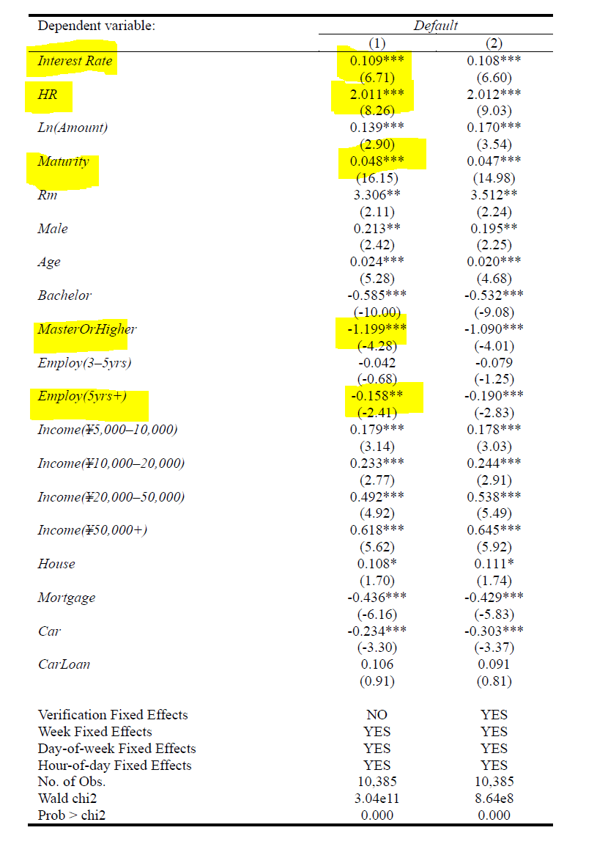
loan DEFAULT
Create a default fummy variable
1 if a loan I defaults on day t
Run a Cox proportional hazards model
High interest rates are more likely to default
Even after controlling for interest rate an HR rating still predicts a higher likelihood of default
This implies that for loans with a given interest rate investors can reduce their exposure to default by avoiding HR loan

Slide 19
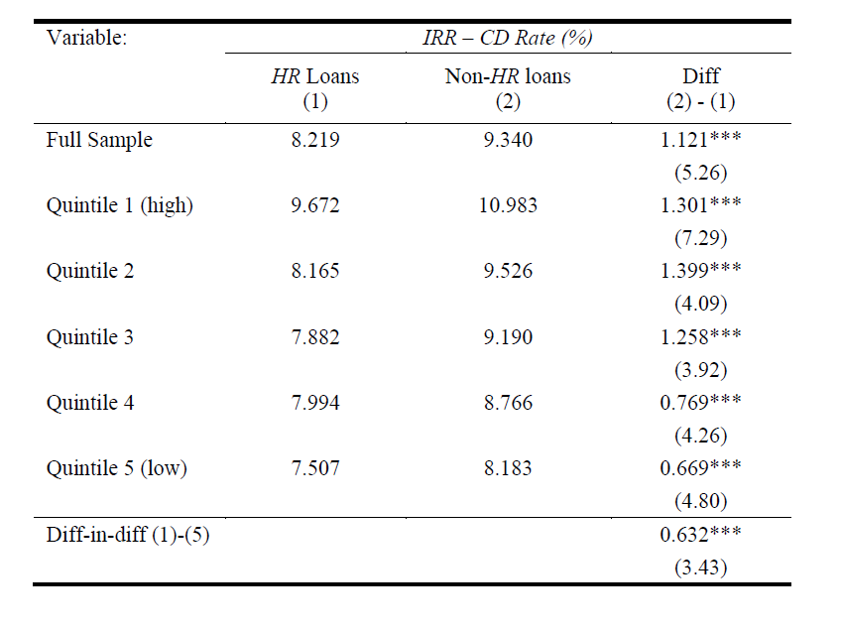
Portfolio-based evidence
The above evidence suggests that many observables, such as credit ratings and other loan and borrower characteristics, are not incorporated into loan prices (ie interest rates)
HR loans underperform non-HR loans by 1.121%
Had investor paid attention to credit ratings, they could have increased their investment return
The difference in performance between HR and non-HR loans should be larger for loans with higher interest rates
Principal guarantee
Investors lose more interest payments (higher interest rate bigger consequence

Slide 20
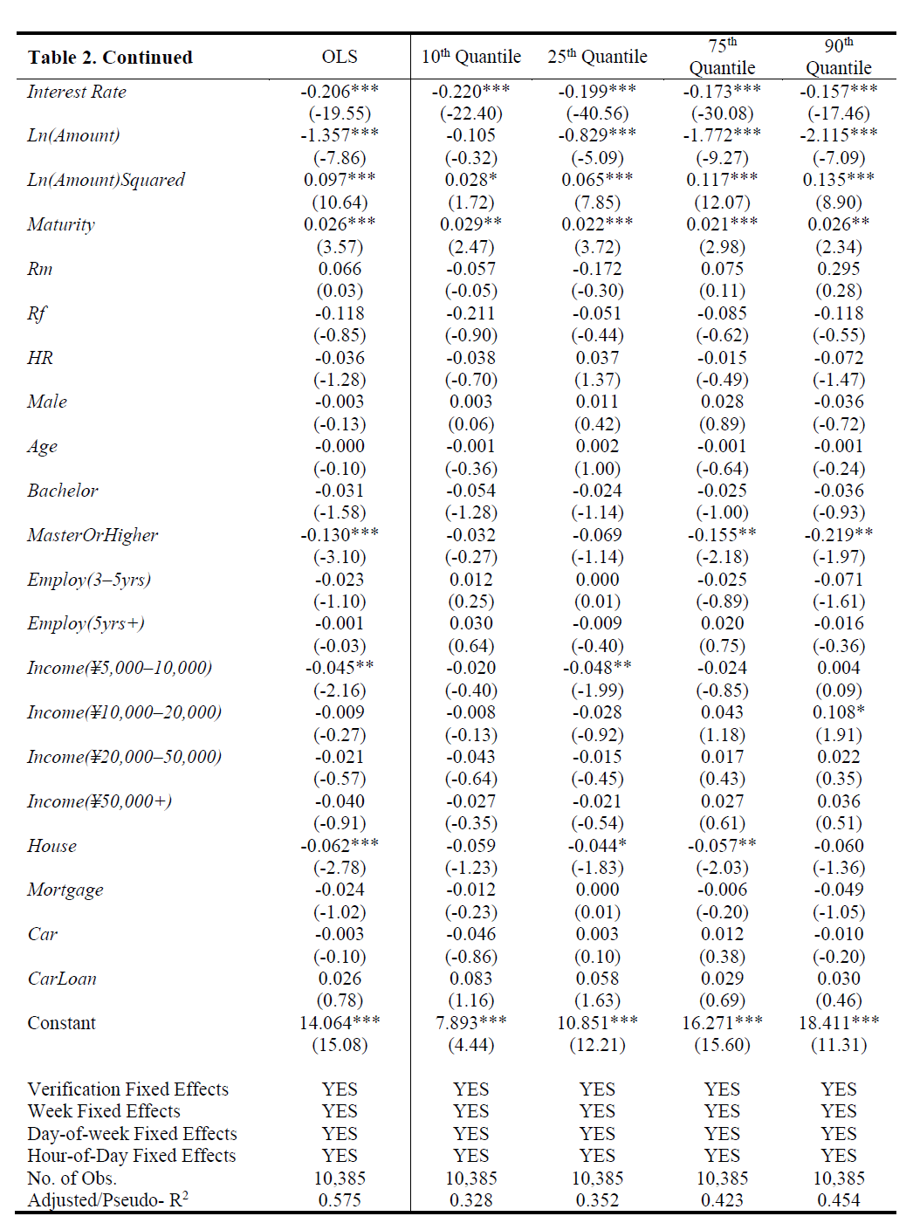
Time PreSSURE
In the previous section, we find correlation between interest rate and fulfillmentTime. However, it does not establish a causal relation between time pressure and reliance on interest rate
Empirical evidence
Run quantile regressions
Col 2 through col 4
The coefficient estimate for interest rate is negative
For faster loans investors must rely on more on interest rate
Lower the quantiles more responsive to interest rate

Slide 21
Interest rate against q of ln(fulfillmenttime)

Slide 22
Time pressure continue
Experimental evidence
60 subjucts
Facing time pressure, participants in the treatment group were more likely to choose HR loans
When investors are under pressure to make decision quickly, they are more likely to focus on interest rates
High interest rates, exposing to higher default risk and earning lower returns （偷鸡不成蚀把米）

Slide 23
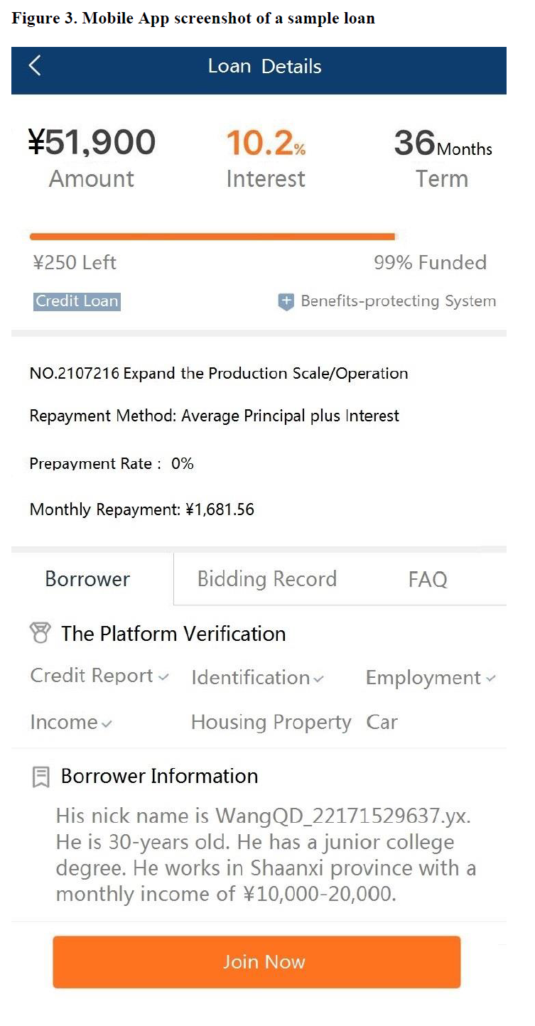
The role of salience
When making quick decisions, people are more likely to rely on salient information and underreact to relevant but less salient information.
In our case, credit risk
Empirical evidence: mobile app
Interest rate in in the middle but credit rating of the borrower is not shown at all

Slide 24
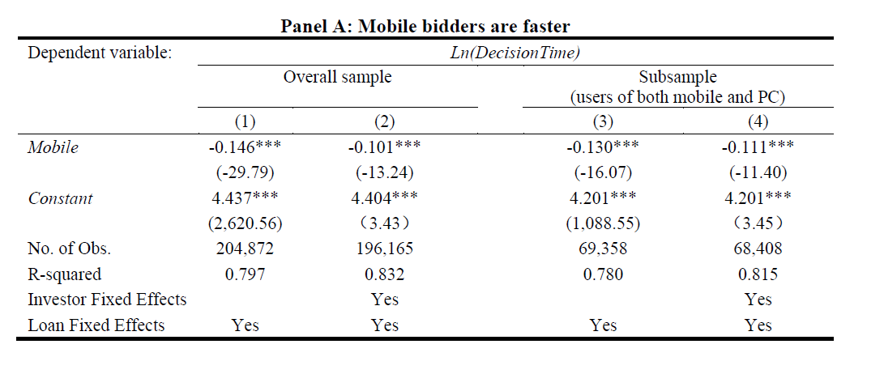
continue
1.Mobile-based investors should make decisions more quickly than computer-based investors
2.Loans with higher interest rates should attract a larger fraction of mobile-based investors
Col (1) the coefficient of mobile is -0.146 that is mobile bidders are about 14.6% faster than PC bidders on average
Col(2) even the same investor tends to bid 10.1% more quickly

Slide 25
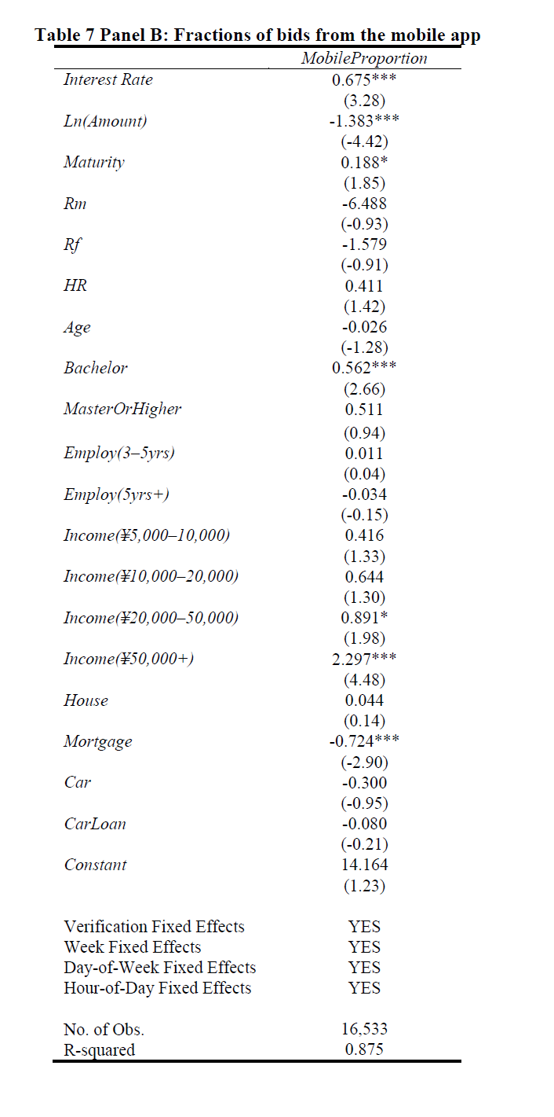
continue
To test second prediction, we regress MobileProportion for each loan on interest rate,HR and control variables
The coefficient of Interest Rate is 0.675
This is consistent with our interpretation that mobile investors pay more attention to interest rates.
In contrast, the coefficient of HR is statistically insignificant

Slide 26
Continue
Experimental evidence: Nudging
Ignoring the information provided by credit ratings is quite costly (偷鸡不成蚀把米）
Can we nudge investors to improve their decisions?
Find 105 subjects and conducted training
Group 1 saw the original interface; Group 2 subjects saw interest rate in a reduced font size and less prominent position; and Group 3 subjects saw the interface with credit rating in a larger font size in orange

Slide 27
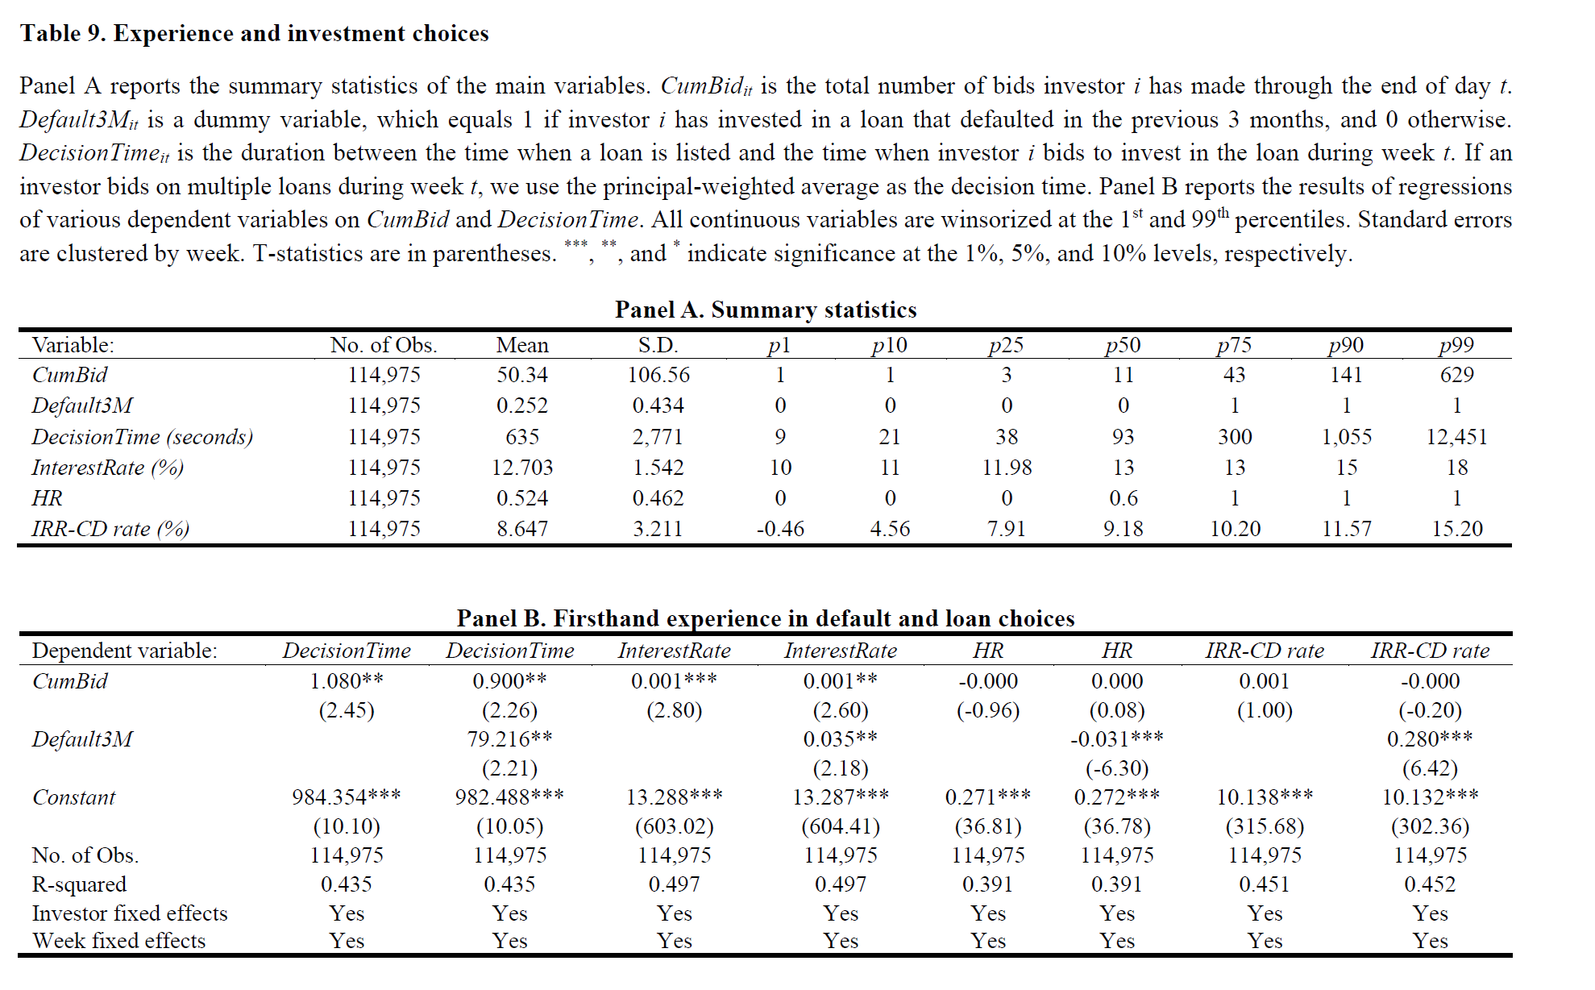
lEARNING
Empirical evidence
Regress DecisionTime on CumBid (coe=1.08)
Experience slow down investor
Regress Default3M in the regression (coe=79.216)
Personally experiencing a loan default, an investor takes almost 80 seconds longer to make investment decisions
Regress of HR on experience
Prior lending experience has a negligible effect on an investor’s willingness to invest in a high-risk loan
In contrast experiencing default firsthand has a much stronger effect
The coeff of Default3M is -0,031
Regress the IRR-CD
Experience has a negligible effect on the investor’s performance
Recent default firsthand experience increases an investor’s return by 28 basis points per year

Slide 28
Experimental evidence
Recruited 68 subjects
In summary consistent with our interpretation, participants pay more attention to credit ratings and less attention to interest rates after they gain more investment experience
Observers and participants learn differently
The most likely explanation for our findings is the difference in psychological reactions between participants and observers. (Stranger’s tear is only water)
First hand experience matters!

Slide 29
conclusion
The paper analyzes investment decisions when fast thinking prevails
Cosidering borrowers credit rating can significantly improve investment decisions
Firsthand experience matters for learning
Our empirical and experimental evidence suggests that this result cannot be fully explained by the wealth effect, the selection effect, or attention
Conjecture is that psychological responses to first experience are different from the responses to other experiences

Slide 30
Critique
Culture of gambling
Policy intervention

